Slide 1

Final Project
Hotel Management
Project Abstract:
This case study details the development of a comprehensive hotel management web application designed to streamline hotel operations, enhance guest experiences, and optimize the booking and room management processes. The platform is intended for use by hotel staff to manage bookings, room availability, customer interactions, and services efficiently.

Slide 2
Objective:
To create a robust, secure, and user-friendly hotel management system that facilitates efficient hotel operations, improved customer service, and streamlined communication between the hotel staff and guests.

Slide 3
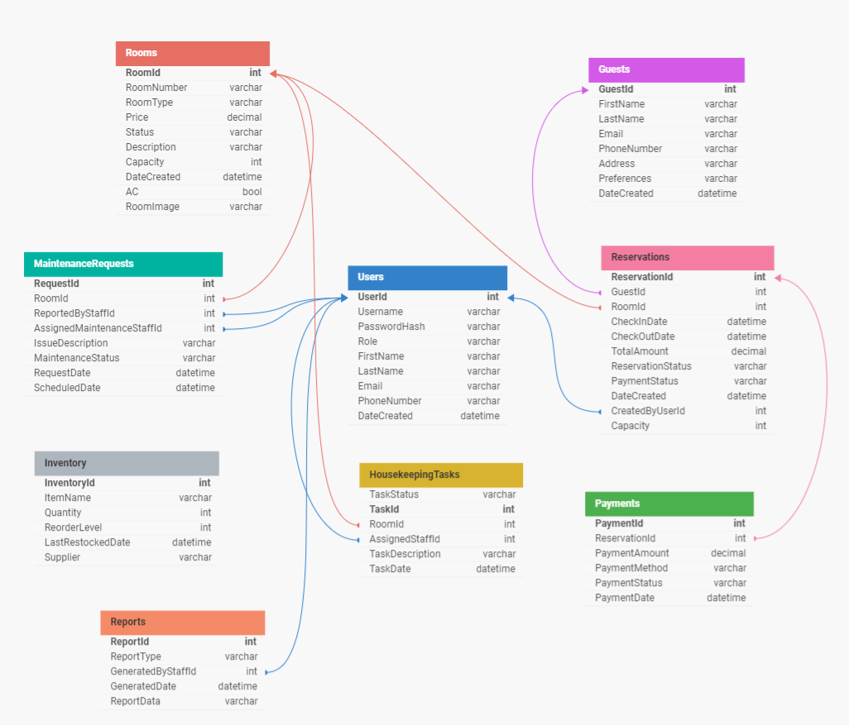
Database Design

Slide 4
Modules
1.Admin Module:
Task Assignment: Assign tasks to housekeeping staff.
Room Management: Manage rooms,updating room details,adding new room,removing existing rooms.
Reporting: Generate reports on occupancy rates, revenue, and other key performance indicators.
Staff Management: Manage staff roles, schedules, and access to the system.
Inventory Control: Manage inventory for hotel supplies.
Issue Reporting: Log and track maintenance issues.

Slide 5
2.Staff Module:
Check-in/Check-out Management: Manage guest check-ins and check-outs efficiently, including handling room assignments and processing payments.
Reservation System: Allows staff to book rooms, modify reservations, and manage cancellation policies.
Guest Management: Maintain guest profiles, preferences, and history to provide personalized services.

Slide 6
3. Housekeeping Module:
Task management: Admin assign maintenance task to particular housekeeping staff that staff complete that task.
Task Status : Initially status is pending staff complete that task it update into success.

Slide 7
Thank You

